Slide 1
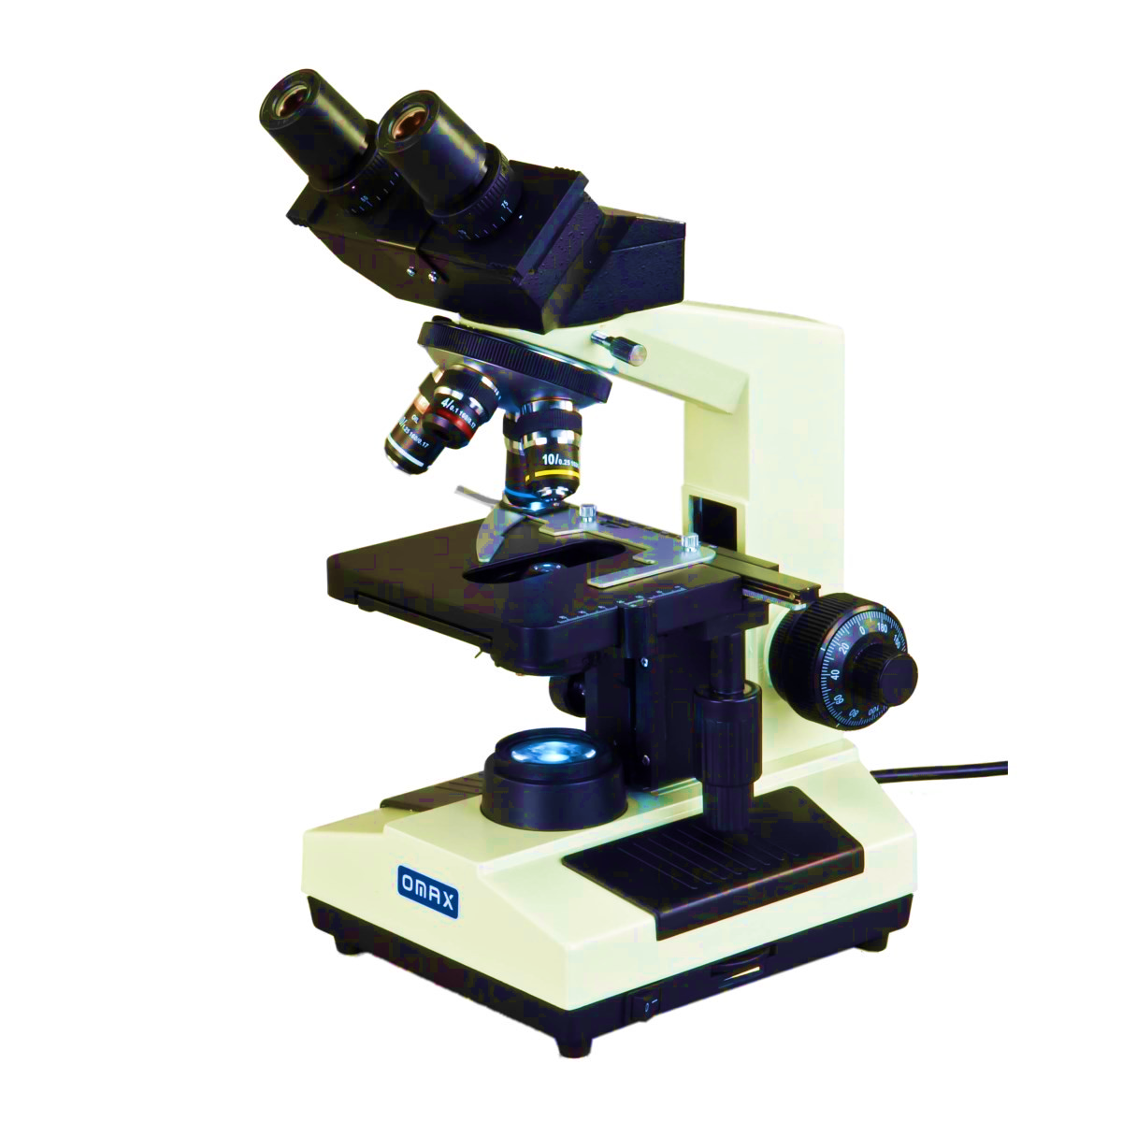
BT233 – General Microbiology Laboratory
Microscopes and Preparation of Wet Mount Slide of Bacteria
Week#2

Slide 2
The Microscopes
It is an instrument used to see objects or parts of the object that are too small to be seen by the naked (unaided) eye.
Concepts of the microscopes:
Magnification: It is the ratio of the size of the image to that of the object
Total magnification= Magnification of ocular lens X Magnification of objective lens
Contrast: the ability see a particular details against its background.
We can use stain to increase it.
Resolution: the ability of a microscope to show two closely lying points as two distinct points. It increases with magnification.

Slide 3
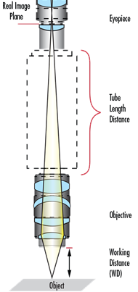
Microscopic field: the part of the specimen that can be seen under the microscope.
It decreases with magnification.
M1 X DFV1 = M2 X DFV2
M1 : Magnification of the first objective lens
DFV1: Diameter of the field of view with first objective lens
M2 : Magnification of the second objective lens
DFV2: Diameter of the field of view with second objective lens
Working distance: the distance between the objective lens and the specimen.
It decreases with magnification.

Slide 4
The microscopes may be:
Simple microscopes: is generally considered to be the first microscope. It combined a convex lens with a holder for specimens and Magnify between 200 and 300 times.
Compound Microscopes: Two lenses, the second lens magnifies the image of the first and they may be binocular or monocular. These devices provide a magnification up to 1200 times, but the resolution is low.

Slide 5
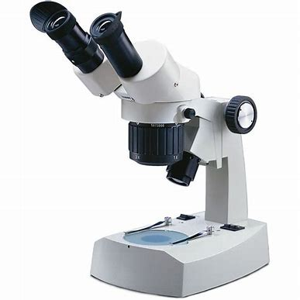
Types of Microscopes
Based on what interacts with the sample to generate the image
Optical Microscopes: Use visible or invisible light to create image,
Compound Microscopes:
- The specimen is then magnified by a series of lenses, one near the slide (called the objective lens) and one
near the top (called the eyepiece).
- The light lit the specimen from underneath
- Two-dimensional image
- Magnify up to 2500 X
- Low resolving power
Stereo Microscopes :
- The specimen is usually lit from above
- Use with any opaque specimen
- Create three-dimensional images
- Low magnification ( 10X – 50X)
- Lower resolutions than compound microscopes

Slide 6
Fluorescence microscope:
- use invisible light such as UV light, when UV light hit specimen
stained with fluorescent dye it will emit visible light with increase
in the resolution of the object.
- Allows observation of fluorescence images.
- It is possible to only observe specific areas by using different
fluorescent labels.
Electron Microscope: - Use a beam of electrons to form image.
- Use electromagnetic lenses instead of glass lenses
- Very high resolving power
- Two types:
Transmission electron microscope (TEM):
Give ultrastructure of the cell
Give 2D image
Total magnification (over 20 millions X)

Slide 7
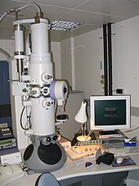
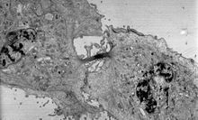
Transmission electron micrograph of a dividing cell undergoing cytokinesis
TEM

Slide 8
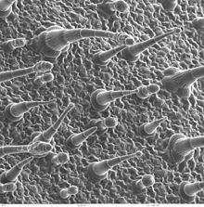
Scanning electron microscope (SEM):
Give topography image for the surface of the cell
Give 3D image
Total magnification (over 20,000X)
Leaf surface viewed by a scanning
electron microscope

Slide 9
X-ray Microscope :
- Use a beam of X-rays to create image
- Resolution higher than that in optical microscope
Scanning Acoustic Microscope:
Employs sound waves to create image
They can use it to view a sample internally without staining it or causing it any damage
Relies on a beam to scan and penetrate the specimen while it is in water
It has the ability to pick up on sub-micron features, such as popcorn cracking
Able to measure the depth of internal layers

Slide 10
YOU MUST TAKE CARE ABOUT THE FOOLOWINGS WHILE USING OF THE MICROSCOPE :
ALWAYS CARRY THE MICROSCOPE WITH TWO HANDS, ONE UNDER THE BASE, THE OTHER HOLD THE ARM, AND THE MICROSCOPE MUST BE UPRIGHT PARALLEL TO YOUR BODY.
https://1drv.ms/v/s!AnFd9iHZwQC0oylV9P5O-qi8kkIg?e=36Jn65
PUT THE MICROSCOPE GENTLY ON THE BENCH AND AWAY FROM THE EDGES.
DO NOT DRAG OR SHOVE THE MICROSCOPE ACROSS THE LAB BENCH.
SWITCH ON/OFF THE MICROSCOPE FROM THE MICROSCOPIC SWITCH, NOT FROM THE MAIN
ELECTRIC SWITCH.
CLEAN THE MICROSCOPE BEFORE AND AFTER USE IT ONLY BY LENS PAPER.
* The first for all optical parts of the microscope EXCEPT oil
immersion lens, starting from eyepiece, objectives, condenser,
then light source.
* The second for oil immersion lens only.

Slide 11
At the end of using the microscope do the followings:
Clean the microscope
Lower the stage to the lowest point
Put the scanning objective lens (4X) at the position (over the condenser)
Tie the electric wire around the arm in a tidy way.
Return the microscope to the cabinet
Put the microscope in the cabinet in such a way that the microscopic arm faced out.

Slide 12
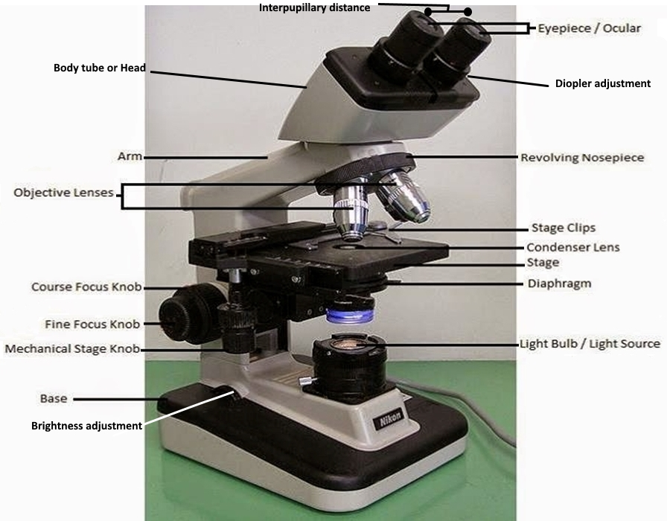
Parts of the Compound Microscope
https://1drv.ms/v/s!AnFd9iHZwQC0oybQksalM-tFib3e?e=wHlXt0

Slide 13
Parts of the compound microscope (Student Microscope):
Eyepiece: The lens the student looks through to see the specimen. The eyepiece usually contains a 10X or 15X power lens.
Body tube (Head): The body tube connects the eyepiece to the objective lenses.
Arm: The arm connects the body tube to the base of the microscope used to carry the microscope.
Coarse adjustment: Brings the specimen into general focus.
Fine adjustment: Fine tunes the focus and increases the detail of the specimen.
Nosepiece: A rotating turret that houses the objective lenses. The viewer spins the nosepiece to select different objective lenses.

Slide 14
Parts of the compound microscope (Student Microscope):
Objective lenses: One of the most important parts of a compound microscope, as they are the lenses closest to the specimen.
A standard microscope has four objective lenses that range in power from 4X to 100X.
Specimen or slide: The specimen is the object being examined. Most specimens are mounted on slides, flat rectangles of thin glass.
Stage: The flat platform where the slide is placed.
Stage clips: Metal clips that hold the slide in place.
Mechanical stage knobs: These knobs move the stage left and right or up and down.

Slide 15
Parts of the compound microscope (Student Microscope):
Illumination: The light source for a microscope
Iris diaphragm: Adjusts the amount of light that reaches the specimen.
Condenser: Gathers and focuses light from the illuminator onto the specimen being viewed.
Base: The base supports the microscope and it’s where illuminator is located.

Slide 16
Objective lenses:
Dry objective lenses: Scanning (4X), 10X, 40X
Wet objective lens: may be one or two (100X) using oil.

Slide 17
Viewing of a specimen under Compound Microscope
The instructor should show the students practically How to focus the specimen under the Microscope.
3. How to use compound microscope.mp4
During focusing the specimen, you must take care about the following:
Fix the slide by stage clip
Put the light spot at the center of the specimen
Lower the stage to the lowest position
Start with the lowest light intensity
Start with scanning objective lens (4X)
After you see the image under certain lens move the slide by adobe knob to check if what you see
is the image of the specimen and to center the specimen
Don’t lower the stage from the starting point of focusing up to seeing the image under oil immersion

Slide 18
Aseptic Technique
During working in microbiology labs, you must take care about the followings:
Yourself and your classmate without infections
Outdoor (environment) and the indoor air without pollutions
Your culture without contamination
A- Pure media: A special nutrients where the bacteria
grow, but without bacteria.
B- Culture: Media with bacteria
The laboratory without any accident

Slide 19
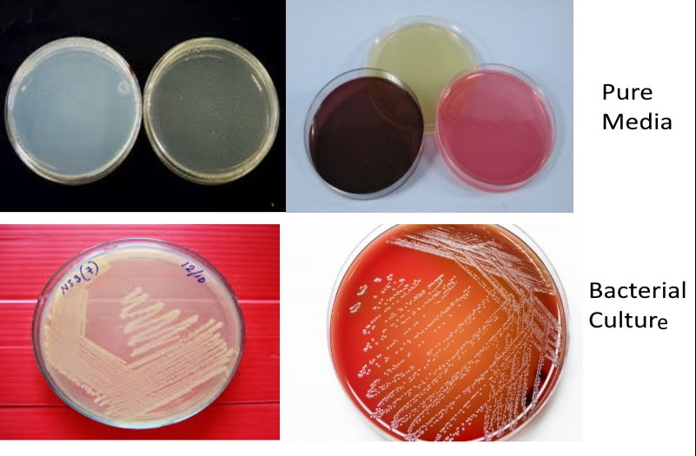
Bacterial culture:

Slide 20
After doing your work You must:
Turn off the Bunsen Burner
If you work with microscope clean and return it to the cabinet in a proper way
Organize your workplace
Sanitize your bench top by disinfectant or 75% alcohol to prevent infections for the others
Wash your hand with liquid soap and tap water then sterilize them with antiseptic before leaving the lab.
Wear off the lab coat outside the lab.

Slide 21
Wet mount Preparation of Bacteria
To do Wet mount slide for bacteria we need:
https://1drv.ms/v/s!AnFd9iHZwQC0oypcEBRDL1qowmrq?e=Xt3UnE
Sterile cleaned microscopic slide: we can clean the slide as the followings:
A. Wash the slide with liquid soap and tap water
B. Rinse the slide with tap water
C. Dip the slide in absolute alcohol for 15 minute to remove the
traces of soap and kill all types of the bacteria on the slide
(sterile)
D. let the slide to dry near the Bunsen Burner
Coverslip

Slide 22
Sterile Distilled water:
Sterile: free of Microorganisms
Distilled water: free of chloride ions, suspended things, and
salt traces.
If you have a sample of water, How you can know if the sample is Tap water, Distilled water, or Deionized water?
Take the water sample and add to it AgNO₃ if the sample become milky suspension this means the sample contains Cl⁻
AgNO3 AgCl + NO₃⁼
^{white ppt}

Slide 23

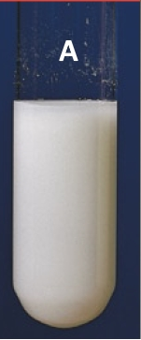
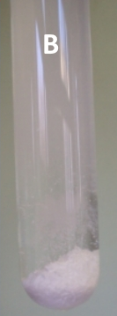

Water sample + AgNO₃
* Milky suspension
* Conduct electric
Tap water
No milky suspension either
Distilled or Deionized water
Can’t conduct electric
Conduct electric
Deionized water
Free of ions
Distilled water
Contains ions except cl⁻

Slide 24
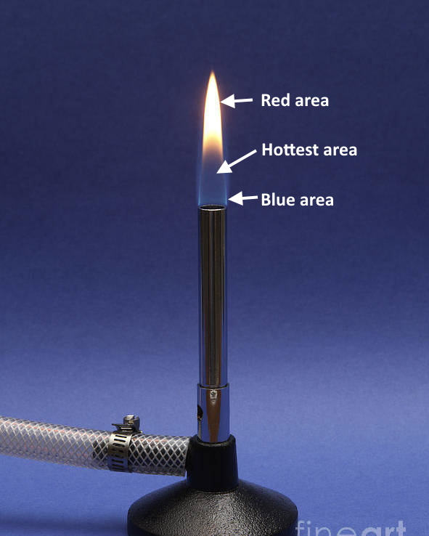
Sterile inoculating loops:
we sterilize the loop in the hottest
area of the flame (colorless region)
and the loop must make an angle
with the flame

Slide 25
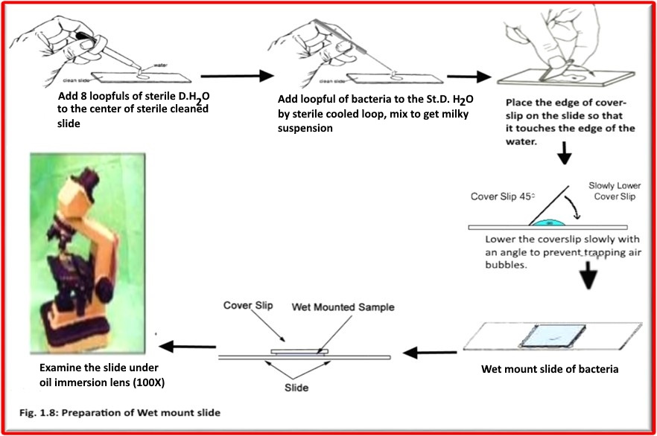
Preparation of Wet-Mount Slide
https://1drv.ms/v/s!AnFd9iHZwQC0o1EtrdkqjYa3MfwV?e=rTAfAS

Slide 26
Conclusions
The microscopic field: The part of the specimen that can be
seen under the microscope at specific magnification
The microscopic field decreases with magnification
The working distance: Is the distance between the objective
lens at the position and the specimen.
The working distance decreases with magnification
When the magnification increases the light intensity must
be increased

Slide 27

The image under low magnification is smaller and darker than that under higher magnification.
Resolving power of the microscope increases with magnification
The bacterial cells are minute (very small) and colorless, impossible to be seen by the naked eyes and hard to see under the microscope.

Slide 28

Bacteria either:
I. Non – motile : A. when the bacteria move in one
direction (liquid movement)
B. Vibrate at the same place
(Brownian movement)
II. Motile: When the bacteria move in all directions
https://1drv.ms/v/s!AnFd9iHZwQC0o1KabaCulLbz2vkL?e=O8yEHE

